Slide 1
VIT Vellore_VIT VELLORE_Devtos
Sourav Dey
Shivam Kumar Pandey
Cognitive Automation: Helpline (Automation)
Use Hosting on AWS ppt for final steps

Slide 2
Detailed Proof of concept
Most companies are already automating their first stage of customer care via Chat Bots and IVR systems.
Most chat bots do not work properly.
IVRs consume a lot of time, are very complex, and most customers end up speaking to a representative instead.
Representatives only work from 9-5, and need holidays, so to provide 24hr support, expenses are high.

Slide 3
Detailed Proof of concept
Most call servers have inbuilt commands and codes to interact with it.
These can be connected to a python script to automatically pick a call, deliver a pre-decided customer friendly message and record their complaint.
This recording can be transcribed and summarized and directly forwarded to a higher level person (ticket generation and escalation). This eliminates the middleman, whose sole purpose was to pick up call and generate a ticket.
We can also create our spam list and cross reference, before picking up the call, to prevent server overuse by spammers.
Depending upon the company, we will have to modify the model based on their terminologies of business.

Slide 4
Sample solution
We have used Twilio for setting up the call handler. It comes with its own set of TwiML commands to interact with the server.
We used python and flask to create the server to connect with Twilio
We used google’s text to speech to transcribe the call(could be done with Twilio’s inbuilt services, but we wanted to make it more platform independent)
Then we built a NLP script to summarize the call details.

Slide 5
How to Install
Install Requirements:
Python 3.5
Pip
python -m spacy download en_core_web_sm: will install required language module for spacy
reqsFinal.txt ( pip install –r reqsFinal.txt) will install all required modules

Slide 6
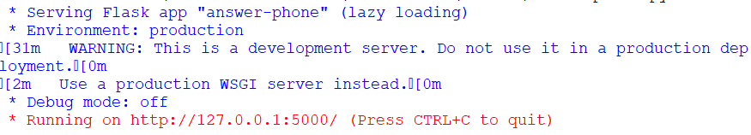
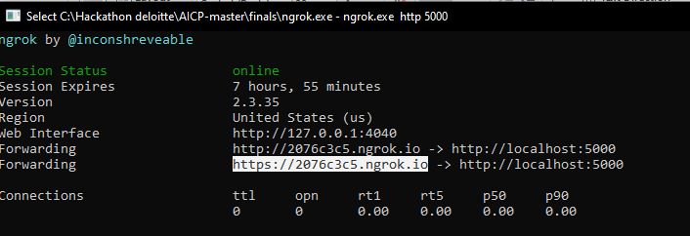
How to setup
Run answer-phone.py for creating server
Run ngrock.exe and pass command -> ngrok.exe http 5000 (or port on which server is running). Copy this https code for later.

Slide 7
How to setup
Log In to twilio:
Go to Phone Numbers(From Left Nav Bar), select the phone number and paste the link copied from ngrok in call webhook, with given link and add “/record”
Press Save

Slide 8
Testing call server
Call the subscribed number.
Call will be received if it is not in blacklist. You can then say your message and disconnect when complete.
Run callDownloadToText.py
You will find call recordings in “audio” folder and transcriptions in the “transcriptions” folder.
These transcriptions will serve as source to be summarized and used to solve customer queries.

Slide 9
Testing Summarizer
Open and run “summarizerSample.py”
The model will train itself from the data given in the code itself. This can be optimized and modified depending upon service provider.
Currently we will see how it summarizes a conversation between two people stored in “convotext.txt”

Slide 10
Original Text
Boss Thank you all for coming today. First of all, I would like you all to meet Mr. Mark Johnson. He is our new salesperson with the company. Here is my number 9003401119 And my email id is msubhaditya@gmail.com I think Mark has met everyone, oh, except for Ann. Hello, Mark. I am Ann Nice to meet you. I am a salesperson, too. It's nice to meet you, Ann Maybe you can help to teach me about my new job. Sure. We can be a .team You help me, I'll help you. That sounds good to me, too. Now let's talk about business. Linda, will you please take notes of our meeting for us? Sure, I have my pen and paper ready. Yes please book a meeting on Tuesday 10pm. I want to book a flight on 10 June 2019. Great. Please read the notes of our last meeting for us. Okay. First, we talked about the budget for next year. I will budget is getting smaller every year. Second, we talked about the new products we are going to selling. She means the new products you and I will be selling. O.K. Third, we talked about the profits that we had last month. And fourth, we talked about the bills we had to pay. We always have more bills than profits. Finally, we talked about raising the cost of our new products. I'm afraid our customers will think our product is too expensive. Why is everyone whispering? Sorry, Linda. O.K. We have a few things to talk about today. Susan, would you like to give your report. Yes, thank you. I have a sales graph I would like to show everyone. This shows how well we are selling our products this year. This line is the sales of our products. And this line is the sales of our competitors' products. So if that line goes up, am I doing a good job? Exactly. O.K. And if that line goes up, does my salary go up? Good question, Ann. We'll talk about that after the meeting. Susan, do we have many competitors? No, not really but enough to keep us busy. Anyway, good job, Ann. I'm sure you and Mark will do even better next month! Thank you, Susan. Very good. Tom, do you have anything to tell everyone. Yes. Don't forget, if you want me to buy something for your office, the deadline is tomorrow. Oh!! I need a new typewriter. Mine is broken. O.K. No problem. If anyone wants me to buy something, tell me before the deadline. O.K. Is that everything? O.K. I think that's all. You can go now. Oh, wait!! Mark has a presentation he would like to give about his new job. Oh, yeah, O.K.

Slide 11
Summarized text
I have a sales graph i would like to show everyone. O.k. I am a salesperson, too. We can be a .team you help me, i'll help you. I need a new typewriter. I want to book a flight on 10 june 2019. great. So if that line goes up, am i doing a good job? Here is my number 9003401119 and my email id is msubhaditya@gmail.com i think mark has met everyone, oh, except for ann. Mark has a presentation he would like to give about his new job. We have a few things to talk about today. Yes please book a meeting on tuesday 10pm. First of all, i would like you all to meet mr. mark johnson. Sure, i have my pen and paper ready. I think that's all. I'm afraid our customers will think our product is too expensive. I am ann nice to meet you. She means the new products you and i will be selling. I will budget is getting smaller every year. Don't forget, if you want me to buy something for your office, the deadline is tomorrow. Oh, yeah, o.k. Anyway, good job, ann. I'm sure you and mark will do even better next month! Thank you, susan.

Slide 12
Thank You

